Slide 1
Colors
Using the best colors for your site

Slide 2
Color Conventions
Color names (blue, red, yellow, etc.) work, but should be avoided
Hexadecimal is common convention
#0000FF, #FF0000, #FFFF00
rgb
(0, 0, 1), (1, 0, 0), (1, 1, 0)
rgba
(0, 0, 1, .5)
#0000FF
#FF0000
#FFFF00
rgb(0,0,1)
rgba(0, 0, 1, .5)

Slide 3
Accessibility
Appropriate use of color is critical to web accessibility
Many more people are visually impaired or color blind than are legally blind

Slide 4
What is color contrast?
You intuitively know when something has poor contrast
There are tools that quantify the contrast between text and its background
http://wave.webaim.org/
http://webaim.org/resources/contrastchecker/

Slide 5
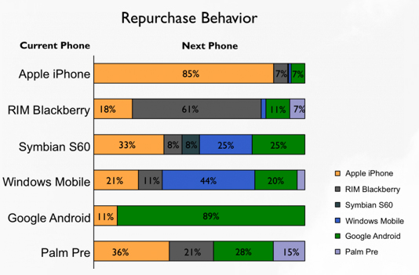
Don’t use color alone to convey meaning

Slide 6
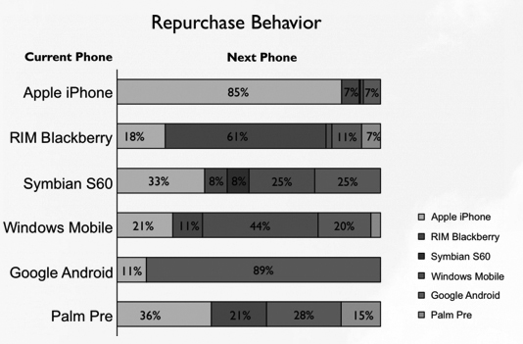
Test in gray scale …

Slide 7
Review
Use web safe colors and use an accepted convention
Test your site using a contrast checker
Avoid using color to convey meaning

Slide 8

Acknowledgements/Contributions
These slides are Copyright 2015- Colleen van Lent as part of http://www.intro-webdesign.com/ and made available under a Creative Commons Attribution Non-Commercial 4.0 License. Please maintain this last slide in all copies of the document to comply with the attribution requirements of the license. If you make a change, feel free to add your name and organization to the list of contributors on this page as you republish the materials.
Initial Development: Colleen van Lent , University of Michigan School of Information

